Slide 1
DEVELOP AN OUTCOME L2
Evidence of Learning Template
NSN : 19896
Project Title : Python Quiz
Daniel Kim

Slide 2
Drive link
Reference
You MUST provide evidence showing how the problem has been decomposed, how the components have been developed and trialled, and of how they have been assembled and tested to create a final, working outcome.

Slide 3
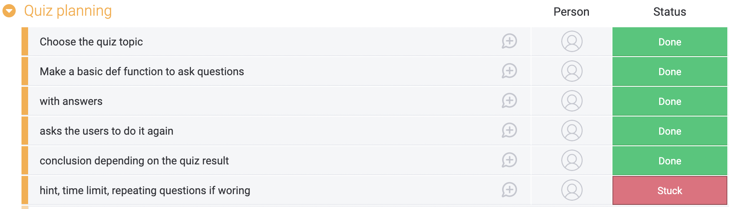
Setup
‘Monday’ is used to plan this project in prior. What i’m going to do can be checked even if it works properly or not ; what I want to add in my quiz, i tried although I failed. This tool has “state” that is useful because I can recognise what’s going on (this technique works properly or other one need to edit more.); the states split into “Working on it”, “Stuck”, “Done”. Additionally, I can split the plan into the smaller for step by step

Slide 4
#2
General knowledge question quiz is selected as everyone could solve it easily compared to specific topics such as law, chemist or economics. This can lead to the interest point.
Some techniques are used such as ‘storing multiple dimensional data [ ], string satulation, methods (returning values, def) and modifying data stored in collection (list).
First of all, using “ def ”, main intro is defined. It asks users’ name and greets them by putting their name restored from main def. The reason of choosing def is that it’s used easily by storing data in codes; the primarily reason of def function is storing the data and able to access easily.
Furthermore, background music(no copyright) will be used and various images will be done during this quiz for understanding questions.

Slide 5
#3
Also, main question is formed by def function to make questions and settings. Storing multidimensional data, each questions is set with ‘def’ and score will be set in this section. Depending on what the users choose, the output will be different.(correct / incorrect)
In this case to make question function, class and __init__ code is used for question and answer. By using self.___ = ___, those variable are defined; questions are simply listed(listing) and answers are stored using multidimensional data structure at each question.
To avoid finishing boring ends, depending on the how much score they would get, comments will be printed differently.(score : 10, 9~4, 3~0)

Slide 6
#4
Lastly, an optional function will be prepared, which decides try this quiz again or quit. For quit selection, the system will be shut while pervious codes for running this quiz is going to be listed again if the users chose yes.

Slide 7
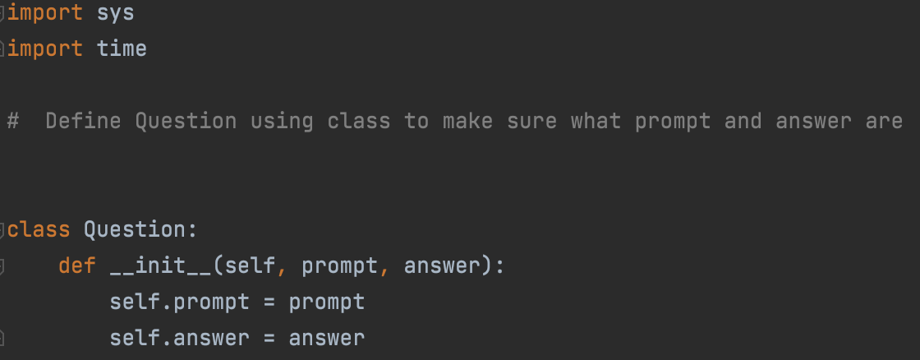
Decomposing outcome #def
“Class” code with “__init__” is used to define questions. In class, named Question, “__init__” is defined as self, prompt, answer.
Through this “def __init__”, next code (prompt which is questions and answer) will come out. This code is used for more simple, complicated and identified easily. It is not like “ Question 1 = [ something ] , Answer 1 = [ 1 ] and Question 2 …” and doesn’t keep listing them. Using def, it is simplified.

Slide 8
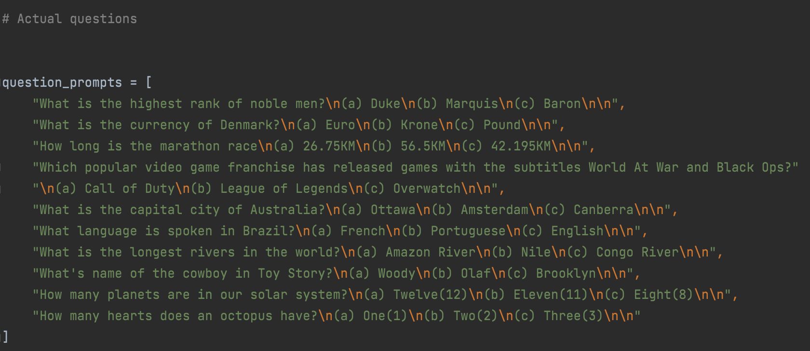
Decomposing outcome #questions
Qusetion_prompts are defined, what question is.
All the questions (without answers) is stored in “question_prompts = {...”
= > general knowledge

Slide 9
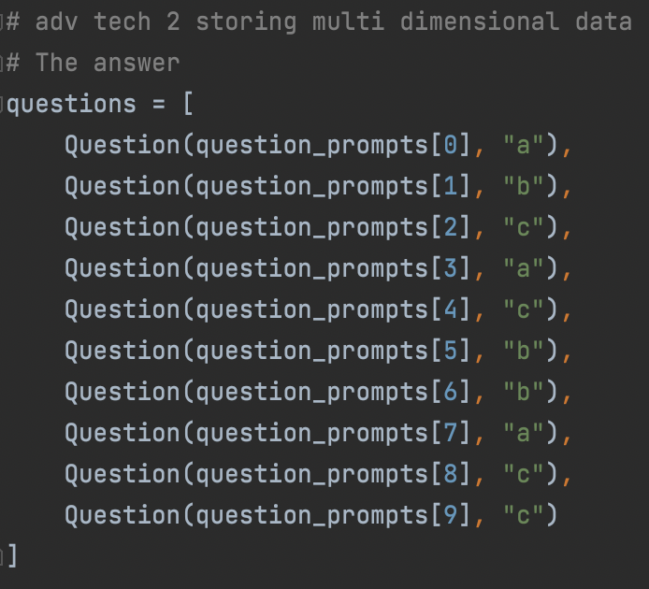
Decomposing outcome #answers
Like previous page, the answers of each question are defined and stored in
question = [ Question(question_prompts[0], “a”)]
, using multi dimensional data with list[].
question is defined as first bracket[ ] is the question number and the letter in “ ” is the answer.

Slide 10
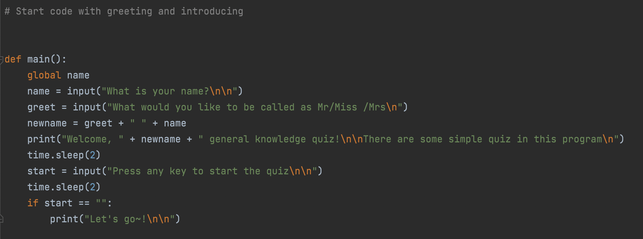
Decomposing outcome #main code(greeting)
This code asks their name to greet the users(salutation) with the name by using “input.” time.sleep is used to give a gap between following quotes for feeling not to crash. Name is globalised(global name) to use it again after.
To prevent from starting quiz automatically when the user is not ready, they have to press any key to initiate this quiz.

Slide 11
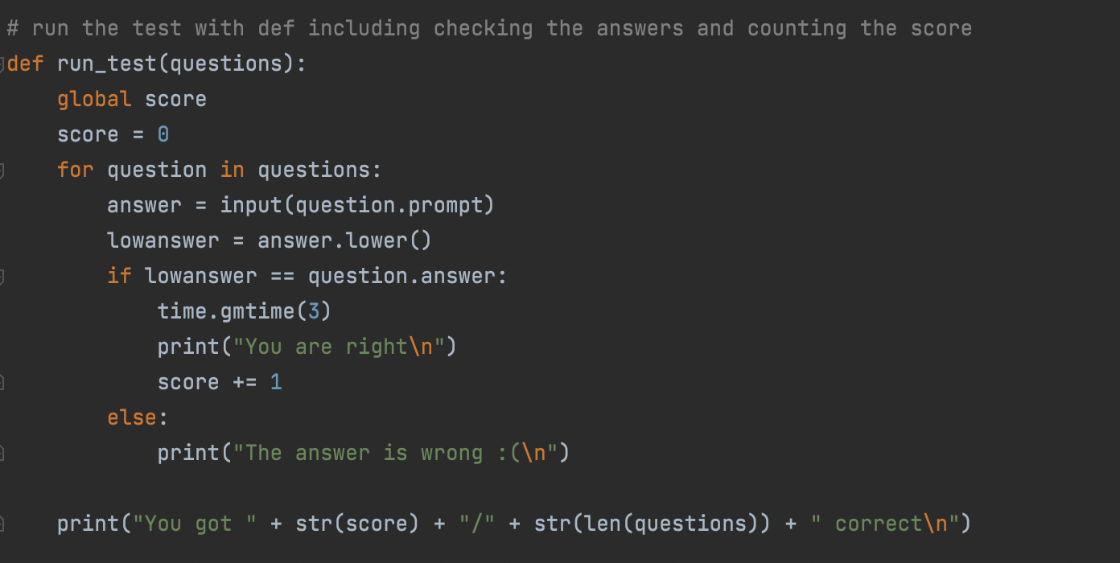
Decomposing outcome #test (solving Q)
With the loop code(for...in...), question will be repeated step by step. The answer that the user thought is right becomes “question.prompt”; it is the answer in the question code I classified before. It is going to check weather the user’s input is right or wrong. Depending of the correction, the user gets a point or remains the same and also the score will be printed to let them know how much score they have for reminders
In addition, whatever they type in capital or lowercase the code will recognise it as lowercase. It helps removing absurd error when they type in capital letters.
Furthermore, score is globalised(global score) to use it later.

Slide 12
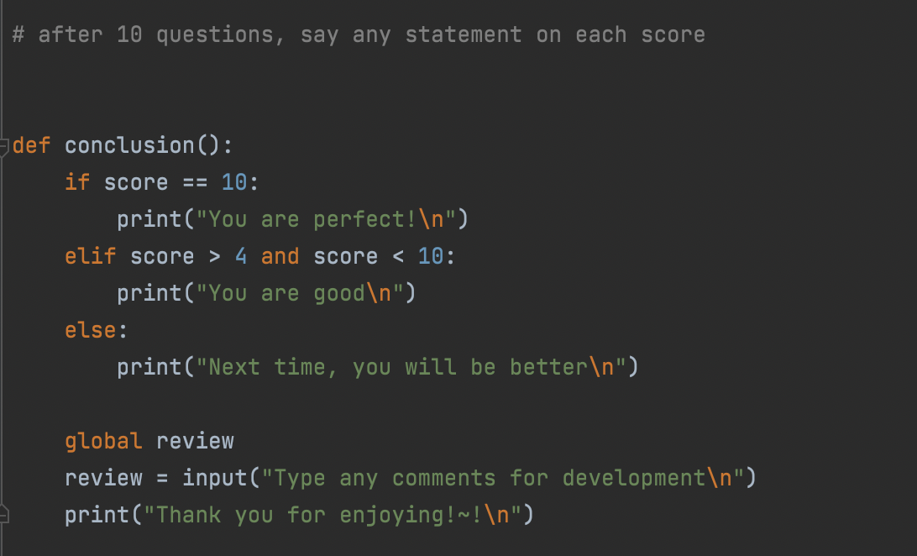
Decomposing outcome #conclusion
This is simply for celebrating the users based on how many questions they are correct with the points. As the score was globalised, it is brought from the previous code(question code) Additionally, they can write any comments as a feedback or review.

Slide 13
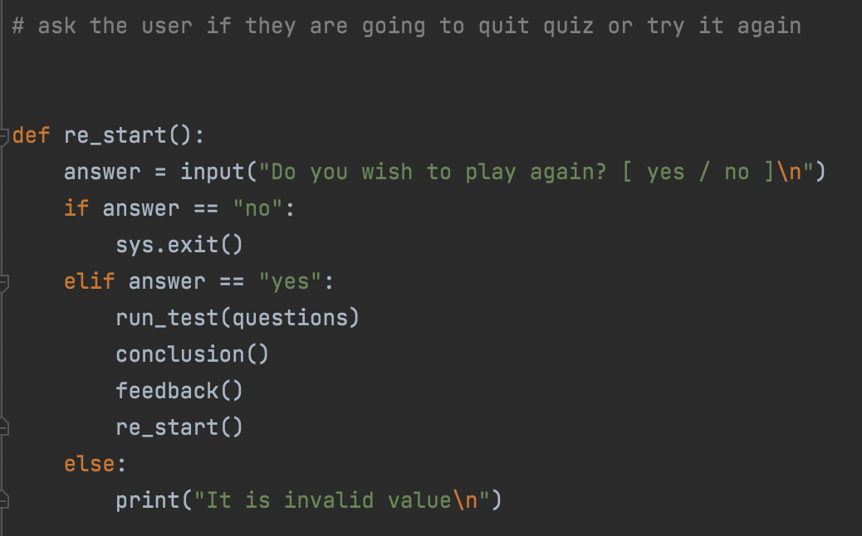
Decomposing outcome #re-start or quit
This is the step to ask the users if they are going to do it again or quit the quiz after finishing it once. By giving a chance to answer it, yes or no, the programme will be exit or it will run again; to do this process, other codes required for the quiz are listed. To quit this system with the answer “no”, at the beginning “import sys” is used.(to use “sys.exit”)
Just in case when they type others, it will print “It is invalid value” as you can see the left.

Slide 14
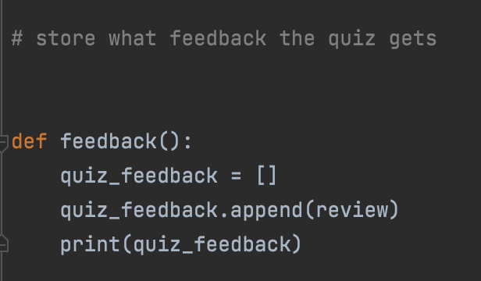
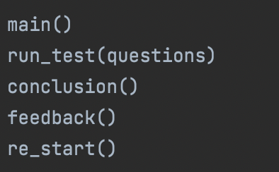
Decomposing outcome # feedback & running codes
By listing the codes that is defined in the previous process, quiz is actually initiated.

Slide 15
Trailing components (1)
I wanted to give one more chance to correct the answer as they failed to choose right things. So, I tried to make the question back by -1 in the question loop. However, it didn’t work and I found out that it cannot be redo or going back as this part consists of the letter, not the number.
Also, for helping the users to choose the answer, ‘hint’ was considered. The trial was putting in the “Class question” like “def __init__(self, prompt, answer, hint): self.hint = hint” and added what the hint is for each question in”question = []” then defined “hint” in the loop”for question in questions: hint”. It didn’t work properly and I couldn’t figure it out

Slide 16
Trialling component (2)
To give exciting atmosphere, I tried to use music and images. First try was to add exhilarating music when this programme starts as background music so, music inserted in ‘def main’ code. However, when it tested, a problem has occurred. Musics was playing and then greeting quotes printed unlike my intention which is that other code keeps working when music is playing, simultaneously. That’s why this idea was rejected.
To help understand what the option is; actual image may output for those who don’t know what it is; using PIL (the way of importing image), I tried to upload image. Unfortunately, it didn’t work because image can be shown only in GUI.
I set review code for users to give comments after the quiz by ‘def.’ I intended to leave and store what they would like to write like feedbacks in specific location such as textpad for programmer to check them later. However it wasn’t stored, unfortunately.

Slide 17
Trialling component (3)
There is a problem to use specific variable in other codes such as name and score. First of all, score is defined in “def run_test ().” and I wanted to use this score again in “conclusion” and score is written. However, in conclusion part, it said “invalid” which means this programme couldn’t get what score is because it didn’t refined. So did name variable. To store data and re-use, these variables must be globalised, using “global score & global name”; this information is collected in w3school.online. [If the variable is globalised by using “global _____”, it is stored and can be used anywhere (in code)]By globalising them, all of the score values is integrated(the same), therefore wherever name and score is used, the results come up the same. That’s why score, how much question the users have get, can be used in conclusion which prints the comments depending on score. Name values which is input at first by the user is save and able to reuse.

Slide 18
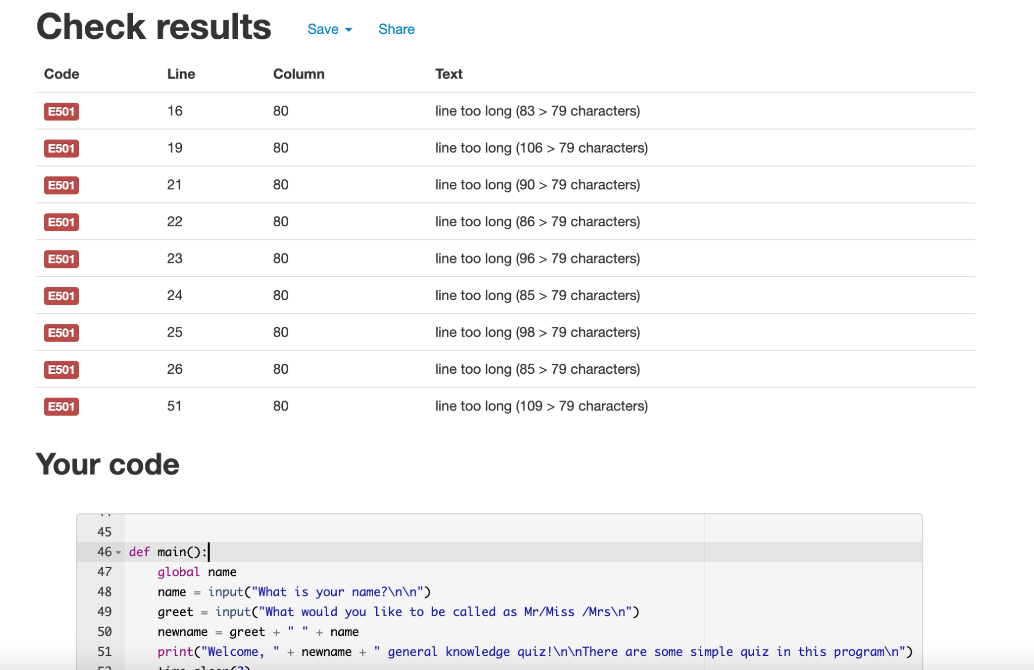
Code Validation
This is a result checked by PEP8. It says some codes are too long as a line but there is no way to be better that’s why it remains the same.

Slide 19
Testing table (1)
Quiz | True | False
1 | a,A - “You are right”, “You got 1/10 correct” | Other values - “The answer is wrong”
2 | b,B - You are right”, “You got 2/10 correct” | Other values - “The answer is wrong”
3 | c,C - You are right”, “You got 3/10 correct” | Other values - “The answer is wrong”
4 | a,A - You are right”, “You got 4/10 correct” | Other values - “The answer is wrong”
5 | c,C - You are right”, “You got 5/10 correct” | Other values - “The answer is wrong”
6 | b,B - You are right”, “You got 6/10 correct” | Other values - “The answer is wrong”
7 | b,B - You are right”, “You got 7/10 correct” | Other values - “The answer is wrong”
8 | a,A - You are right”, “You got 8/10 correct” | Other values - “The answer is wrong”
9 | c,C - You are right”, “You got 9/10 correct” | Other values - “The answer is wrong”
10 | c,C - You are right”, “You got 10/10 correct” | Other values - “The answer is wrong”
This is quiz section. When the users enter the right answer regardless of lowercase or uppercase, it will say “You are right” and “you got __/10 correct” depending on how much questions they are right. Or other values that is typed as an answer, “The answer is wrong” will be printed.

Slide 20
Testing outcome(2)
conclusion()
re_start()
Score | Results
1 | “ Next time, you will be better “
2
3
4
5 | “ You are good “
6
7
8
9
10 | “ You are perfect “
Request to restart or not | Result
“ yes “ | It is going to ask “What is your name?” - it starts again from the beginning where is ‘ main() ’
“ no “ | The programme will be shut down
others | “It is invalid value”

Slide 21
Testing outcome(3)
main()
Print | Input | Result
What is your name? | Daniel
What would you like to be called as Mr/Miss/Mrs? | Mr | Welcome, Mr. Daniel. General knowledge quiz! There are some simple quiz in this program
Press any key to start the quiz | Pressing “spacebar” | Let’s go~!
feedback()
Print | Input | Result
Type any comments for development | Oh, it was good to enjoy simply but some cliche is boring to do this quiz. | Thank you for enjoying!~!

Slide 22
Version Control
Your version control evidence should go here. This could be in the form of annotated screenshots which show you you managed this process or you could make a brief screencast explaining how you implemented version control.

Slide 23
Relevant Implication # Functionality
Functionality - algorithm which is a process of rules to be followed in problem-solving operation is important to form code. It is crucial to does work every codes appropriately, if works as intended or not. Unless, the programme may be in a problem and that leads to the error in process.
Application : Every codes works as intended such as listing question, globalising variable to be used in other def code, recognising answers as lowercase; if users type in capital letters etc. Through a lot of trials, excellent parts are accepted to be better and poor components which didn’t work properly unlike intention, are subtracted, for example playing background music and printing images.

Slide 24
Relevant Implication # Privacy
Privacy - Data is important in any apps. For more excitement, some programme or quiz require users’ information. They can check their own score and compare it with their friends. They are afraid of leaking their private information without any permission therefore data must be protected or should not be used in stealth.
Application : this quiz ask users’ name etc and their comments. However, it does not ask any personal information which can be critical problem when leaking and even their name won’t use in others.

Slide 25
Relevant Implication # Intellectual Property
Intellectual Property Rights(IPR) - IPR is prerequisite for better identification, planning, commercialization and protection of creativity. Shortly, any property which is intended, planned, and proceed as brand-new should be protected from using without permission. Their approvals are required to use property.
Application : None of codes that are used in the quiz is copied and others creativity and rights are protected. To make this programme, some information is collected from w3schools and youtube and those resources are written where these come from.

Slide 26
Relevant Implication # Usability
Usability -this implication is an important principle to determine the success of a system. It intends to make a system as easy to use as possible. The users can handle out this quiz easily and th programme is efficient, effective, engaging error tolerant and essay to learn.
Application : To understand what this programme is all about, what users are going to do and in order to deal with this quiz what they have to do, all of these information is introduced in the beginning so that they can use this quiz easily.

Slide 27
Evaluations
Planning tool (Monday.com) is used to make this outcome and it was helpful to make it step by step. Although plans are not specifically, due to the big chunk plan, I recognised what I had to do, what is next step or what components / codes are required for the development. This affects me planning in prior is helpful indeed to do something.
Through trailing components, whatever the components success or not, progby making other version; the rest of codes remains the same and only trial parts is tested.
Even though I planned this programme as a creator, I imagine and consider this quiz as one of the user, so some idea came up for development. One of them was that to make users feel excited and participated, this programme asks their name and keep typing something

